Slide 1

What I am going to cover
1
2
3
A look at Amazon Q Developer content bundle
Demoing Amazon Q with confidence
Additional content resources

Slide 2
Amazon Q Developer content

Slide 3
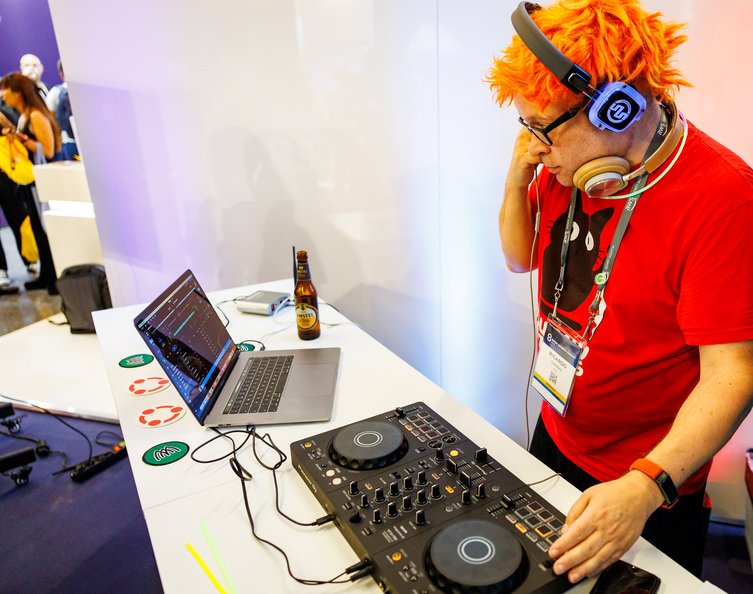

Slide 4
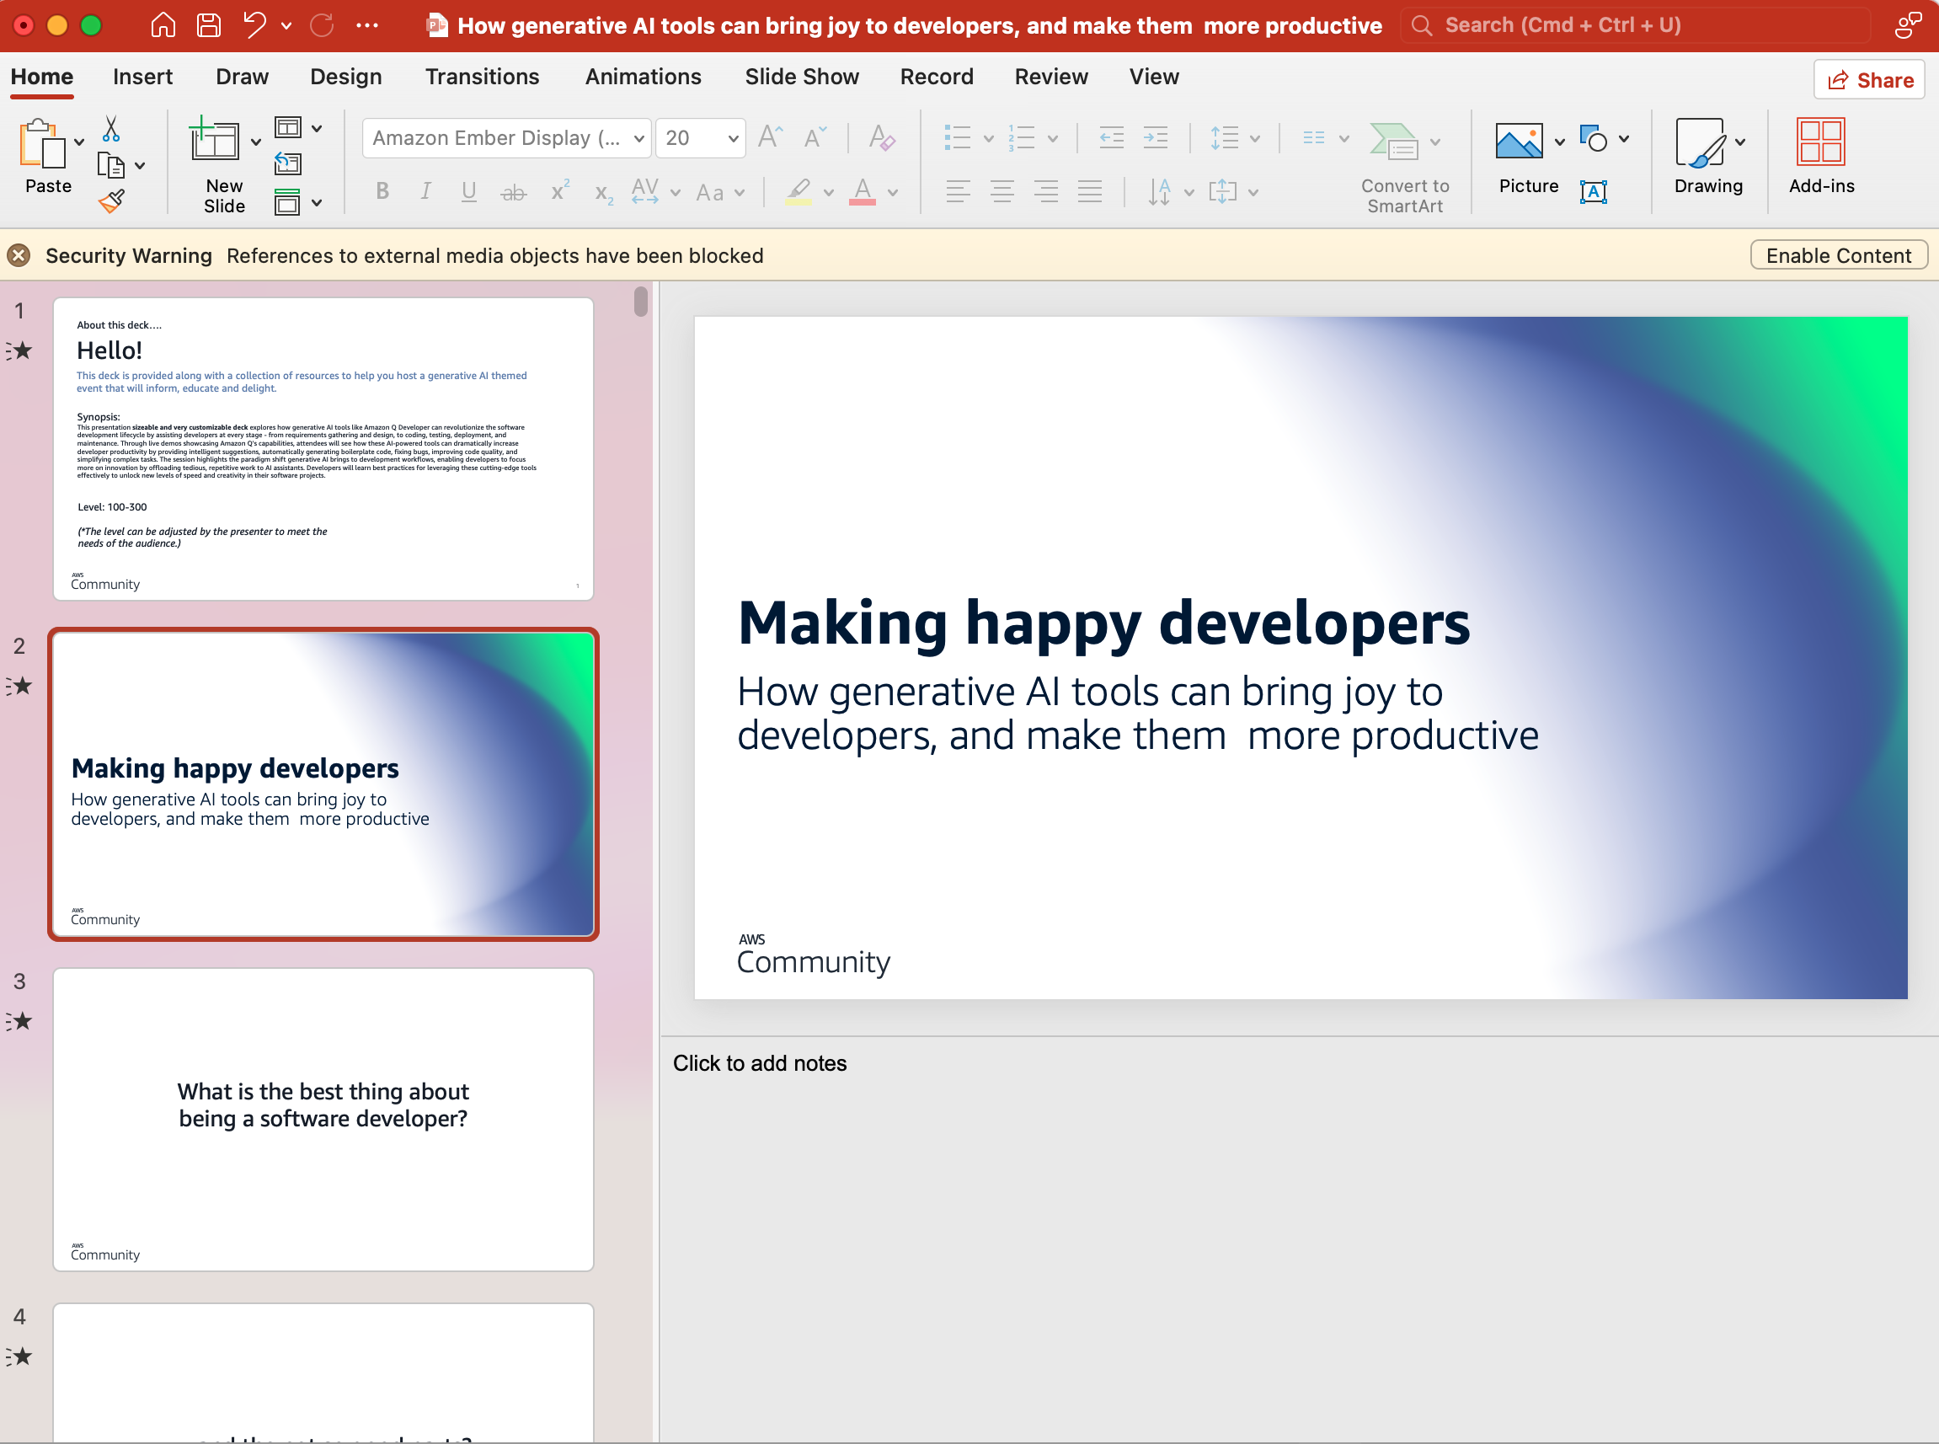
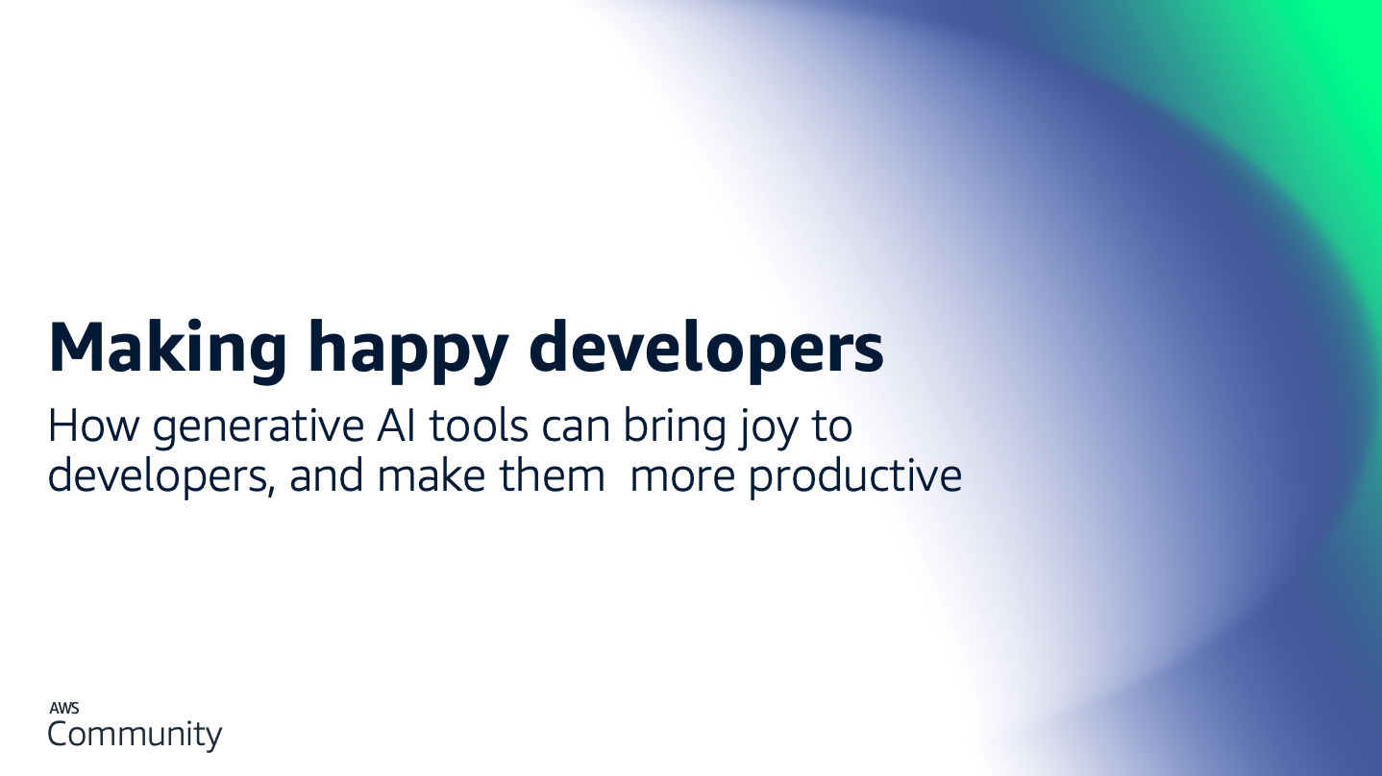
Notes:
Here is the repo of the Java app that was created as part of this deck -> https://github.com/094459/094459-amazon-q-git-demo

Slide 5
Demoing with confidence

Slide 6
1
5
Create a detailed outline and script
Dry run before your demo
2
6
Practice until you feel confident
Demo retrospectively
3
7
Create a backup video of your demo
Embrace failure and earn trust
4
No last minute changes

Slide 7
Additional resources

Slide 8
Additional resources
1
We have some Amazon Q Developer demo slides you can use/incorporate
2
We have a more hands on tutorial/lab that you can use

Slide 9
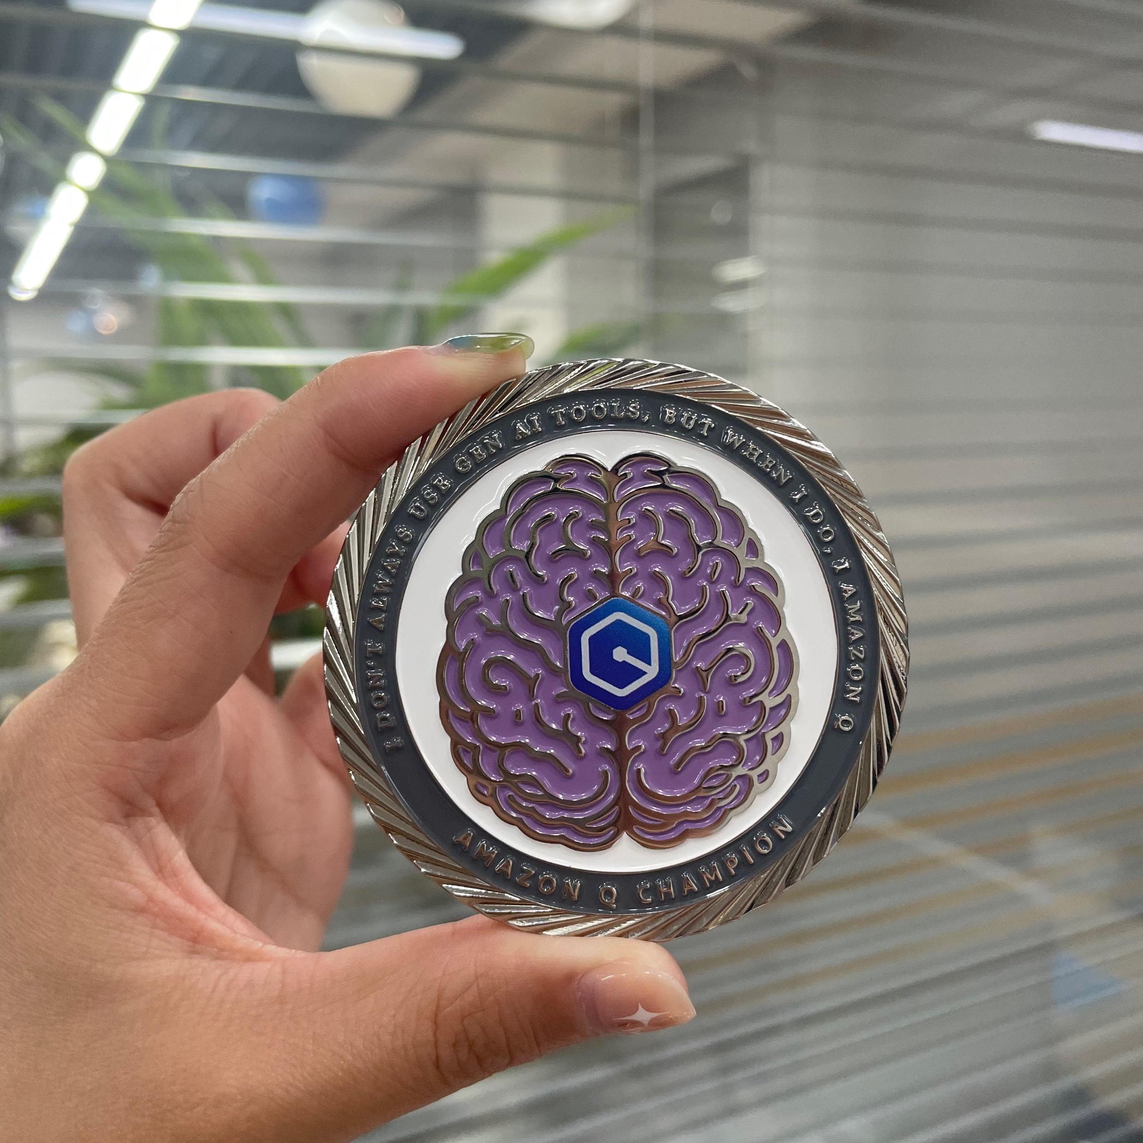
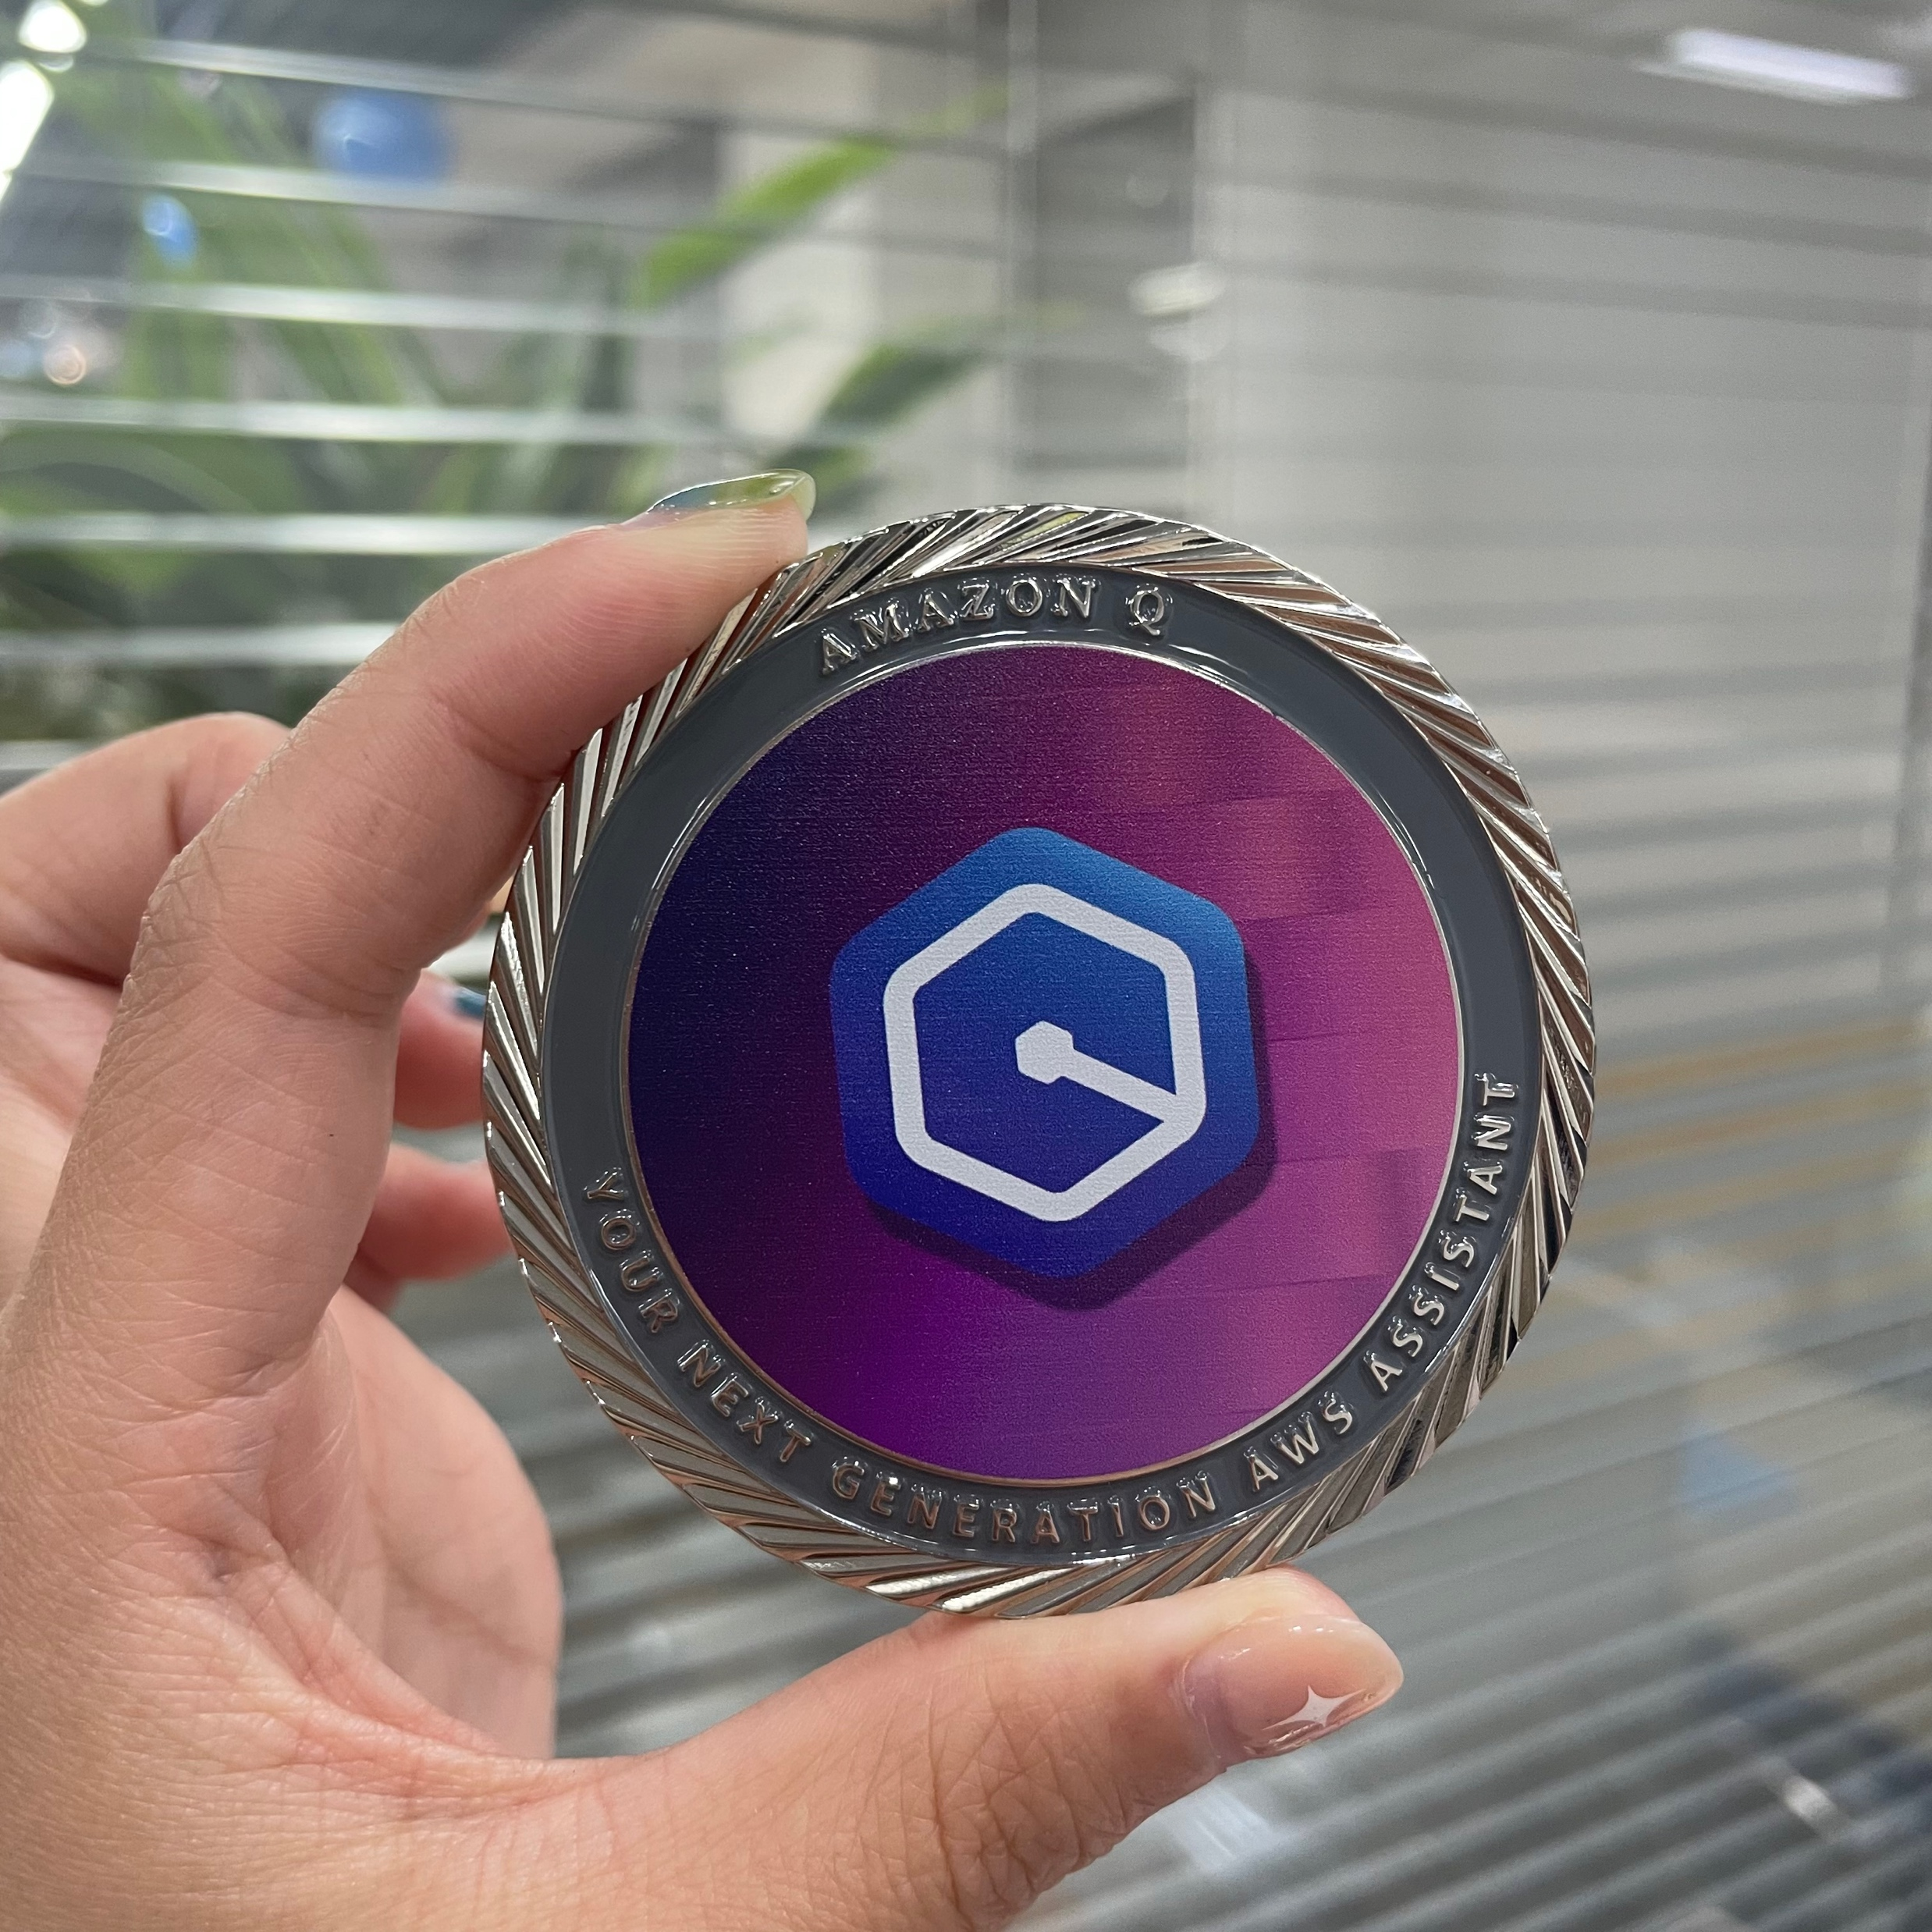

Slide 10
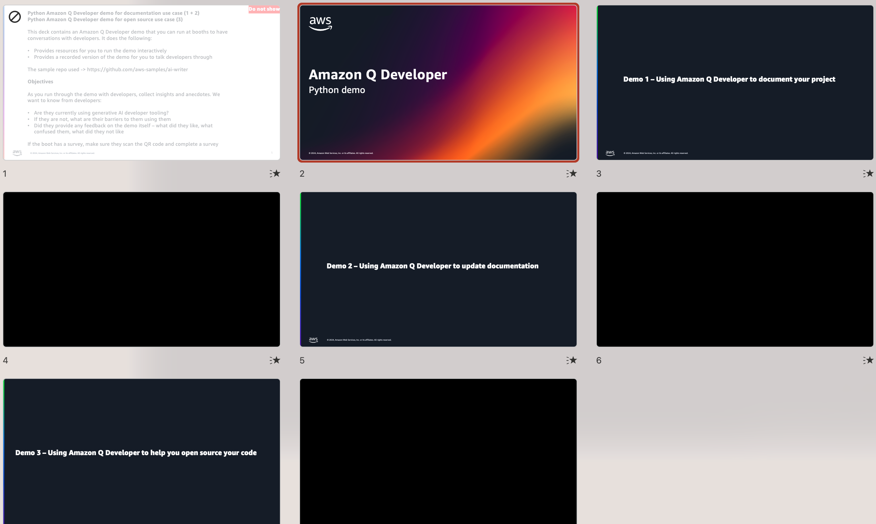
1
How you can use Amazon Q Developer to write your documentation
2
How you can use Amazon Q Developer to document your code
3
How you can use Amazon Q Developer to help you open source a project

Slide 11
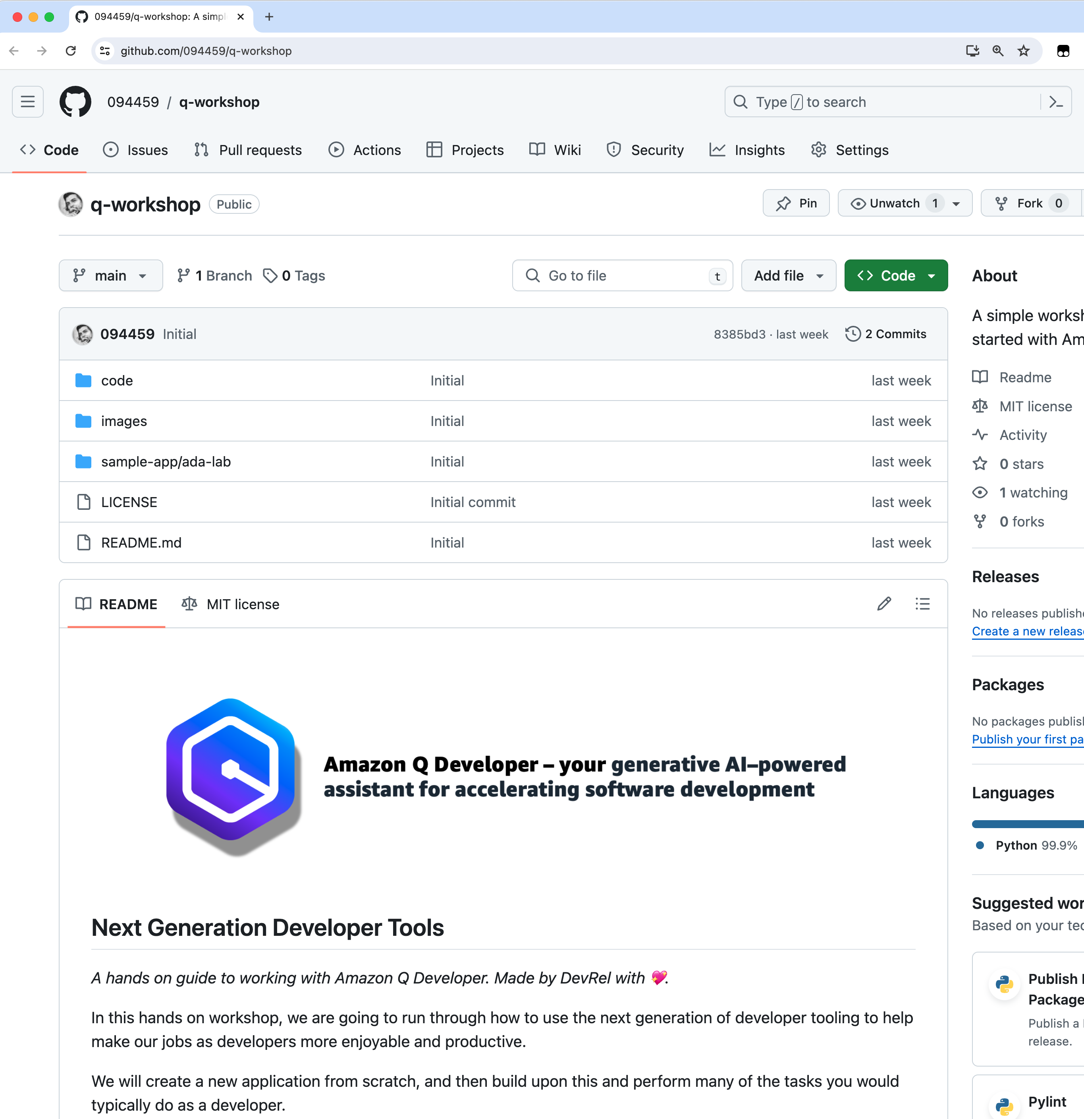
A hands on guide on how to explore Amazon Q Developer
Installation and configuration of Amazon Q Developer
Amazon Q Developer functionality overview
Using Amazon Q Developer to fix, explore, document, test, and enhance a simple demo application
Notes:
Sample repo -> https://github.com/094459/ada-python-demo-app
Hands on lab -> https://github.com/094459/q-workshop

Slide 12
Links to HD videos
The deck contains embedded YT video links. You should configure your setup to display these in HD mode. If this does not work, then you can alternatively embed the videos where are linked here
Analysis and Design – https://ricsuepublicresources.s3.eu-west-1.amazonaws.com/videos/amazon-q/amazon-q-vscode-analysis-and-design.mp4
Develop part 1 – https://ricsuepublicresources.s3.eu-west-1.amazonaws.com/videos/amazon-q/amazon-q-vscode-develop-1.mp4
Develop part 2 – https://ricsuepublicresources.s3.eu-west-1.amazonaws.com/videos/amazon-q/amazon-q-vscode-develop-2.mp4
Develop part 3 – https://ricsuepublicresources.s3.eu-west-1.amazonaws.com/videos/amazon-q/amazon-q-vscode-develop-3.mp4
Develop part 4 – https://ricsuepublicresources.s3.eu-west-1.amazonaws.com/videos/amazon-q/amazon-q-vscode-develop-4.mp4
Develop part 5 – https://ricsuepublicresources.s3.eu-west-1.amazonaws.com/videos/amazon-q/amazon-q-vscode-develop-5.mp4
Develop part 6 – https://ricsuepublicresources.s3.eu-west-1.amazonaws.com/videos/amazon-q/amazon-q-vscode-develop-6.mp4
Develop part 7 – https://ricsuepublicresources.s3.eu-west-1.amazonaws.com/videos/amazon-q/amazon-q-vscode-develop-7.mp4
Develop part 8 – https://ricsuepublicresources.s3.eu-west-1.amazonaws.com/videos/amazon-q/amazon-q-vscode-development-8.mp4
Develop part 9 – https://ricsuepublicresources.s3.eu-west-1.amazonaws.com/videos/amazon-q/amazon-q-vscode-development-9.mp4
Testing part 1 – https://ricsuepublicresources.s3.eu-west-1.amazonaws.com/videos/amazon-q/amazon-q-vscode-testing-1.mp4
Testing part 2 – https://ricsuepublicresources.s3.eu-west-1.amazonaws.com/videos/amazon-q/amazon-q-vscode-testing-2.mp4
Testing part 3 – https://ricsuepublicresources.s3.eu-west-1.amazonaws.com/videos/amazon-q/amazon-q-vscode-testing-3.mp4

Slide 13
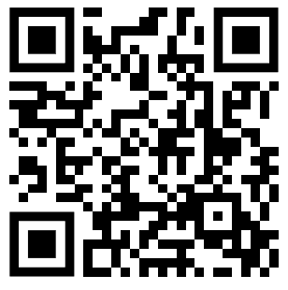
Call to action!
1
Complete Pulse Form - https://pulse.aws/survey/ZUOT5ADE
2
Checkout content bundles that have been upload to the #content-bundles slack channel
3
If you have any feedback, let us know!

